Slide 1
Lexical Analysis

Slide 2
Lexical Analysis
Basic Concepts & Regular Expressions
  What does a Lexical Analyzer do?
  How does it Work?
  Formalizing Token Definition & Recognition
Reviewing Finite Automata Concepts
  Non-Deterministic and Deterministic FA
  Conversion Process
    Regular Expressions to NFA
    NFA to DFA
Relating NFAs/DFAs /Conversion to Lexical Analysis

Slide 3
Lexical Analyzer in Perspective
token
source program
lexical analyzer
parser
get next token
symbol table
Important Issue:
What are Responsibilities of each Box ?
Focus on Lexical Analyzer and Parser.

Slide 4
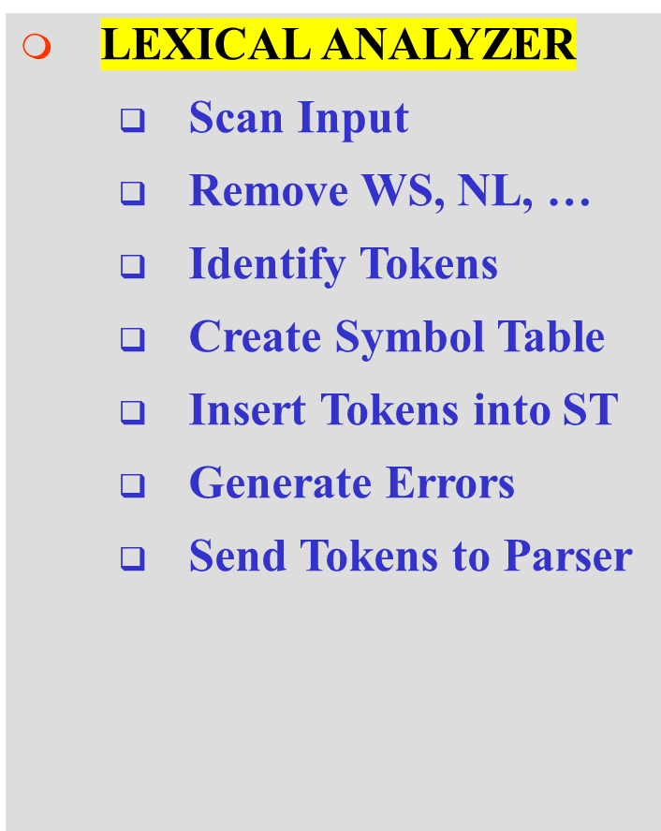
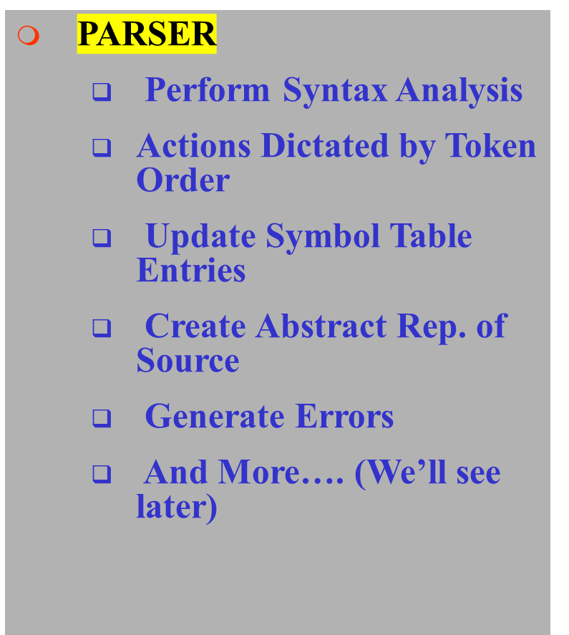
Lexical Analyzer in Perspective

Slide 5
What Factors Have Influenced the Functional Division of Labor ?
Separation of Lexical Analysis From Parsing Presents a Simpler Conceptual Model
  A parser embodying the conventions for comments and white space is significantly more complex that one that can assume comments and white space have already been removed by lexical analyzer.
Separation Increases Compiler Efficiency
  Specialized buffering techniques for reading input characters and processing tokens…
Separation Promotes Portability.
  Input alphabet peculiarities and other device-specific anomalies can be restricted to the lexical analyzer.

Slide 6
Introducing Basic Terminology
What are Major Terms for Lexical Analysis?
  TOKEN
    A classification for a common set of strings
    Examples Include <Identifier>, <number>, etc.
  PATTERN
    The rules which characterize the set of strings for a token
    e.g., digit followed by zero or more digits
  LEXEME
    Actual sequence of characters that matches pattern and is classified by a token
    Identifiers: x, count, name, etc…

Slide 7
Introducing Basic Terminology
Token
Sample Lexemes
Informal Description of Pattern
const
if
relation
id
num
literal
const
if
<, <=, =, < >, >, >=
pi, count, D2
3.1416, 0, 6.02E23
“core dumped”
const
characters i, f
< or <= or = or < > or >= or >
letter followed by letters and digits
any numeric constant
any characters between “ and ” except “
Actual values are critical. Info is :
  1.Stored in symbol table
  2.Returned to parser
Classifies Pattern

Slide 8
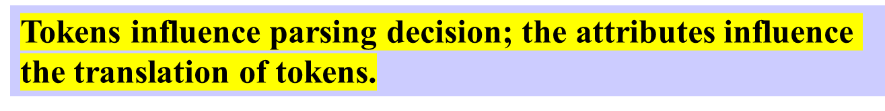
Attributes for Tokens
Example: E = M * C ** 2 (Fortran statement)
<id, pointer to symbol-table entry for E>
<assign_op, >
<id, pointer to symbol-table entry for M>
<mult_op, >
<id, pointer to symbol-table entry for C>
<exp_op, >
<num, integer value 2>

Slide 9
Handling Lexical Errors
Error Handling is very localized, with Respect to Input Source
  For example: fi (a == f(x))
  a lexical analyzer cannot tell whether fi is a misspelling of the keyword if or an undeclared function identifier.
  In what Situations do Errors Occur?
  Lexical analyzer is unable to proceed because none of the patterns for tokens matches a prefix of remaining input.
Panic mode Recovery
  Delete successive characters from the remaining input until the analyzer can find a well-formed token.
  May confuse the parser – creating syntax error
Possible error recovery actions:
  Deleting or Inserting Input Characters
  Replacing or Transposing Characters

Slide 10
Buffer Pairs
Lexical analyzer needs to look ahead several characters beyond the lexeme for a pattern before a match can be announced.
In C, single-character operators like =, or < could also be the beginning of a two-character operator like ==, or <=.
Use a function ungetc to push lookahead characters back into the input stream.
Large amount of time can be consumed moving characters.
Special Buffering Technique
Use a buffer divided into two N-character halves
N = Number of characters on one disk block
One system command read N characters
Fewer than N character => eof

Slide 11
Buffer Pairs (2)
Two pointers lexeme_beginning and forward to the input buffer are maintained.
The string of characters between the pointers is the current lexeme.
Initially both pointers point to first character of the next lexeme to be found. Forward pointer scans ahead until a match for a pattern is found
Once the next lexeme is determined, the forward pointer is set to the character at its right end.
After the lexeme is processed both pointers are set to the character immediately past the lexeme
E
=
M
*
C
*
*
2
eof
Lexeme_beginning
forward
Comments and white space can be treated as patterns that yield no token

Slide 12
Code to advance forward pointer
if forward at the end of first half then begin
  reload second half ;
forward : = forward + 1;
end
else if forward at end of second half then begin
reload first half ;
move forward to biginning of first half
end
else forward : = forward + 1;
Pitfalls
This buffering scheme works quite well most of the time but with it amount of lookahead is limited.
Limited lookahead makes it impossible to recognize tokens in situations where the distance, forward pointer must travel is more than the length of buffer.

Slide 13
Problem?
Except at the end of buffer halves, for each advance of forward requires 2 tests
if forward at the end of first half then begin
  reload second half ;
forward : = forward + 1;
end
else if forward at end of second half then begin
reload first half ;
move forward to biginning of first half
end
else forward : = forward + 1;

Slide 14
Algorithm: Buffered I/O with Sentinels
E
=
M
*
eof
C
*
*
2
eof
eof
lexeme beginning
forward (scans ahead to find pattern match)
forward : = forward + 1 ;
if forward ↑ = eof then begin
if forward at end of first half then begin
reload second half ;
forward : = forward + 1
end
else if forward at end of second half then begin
reload first half ;
move forward to biginning of first half
end
else / * eof within buffer signifying end of input * /
terminate lexical analysis
end
We extend each buffer half to hold a sentinal [eof] character at the end
Block I/O
Block I/O
2nd eof ⇒ no more input !

Slide 15
Token Recognition
How can we use concepts developed so far to assist in recognizing tokens of a source language ?
Assume Following Tokens:
if, then, else, relop, id, num
We can express patterns using regular expressions.
Given Tokens, What are Patterns ?
if → if
then → then
else → else
relop → < | <= | > | >= | = | <>
digit → [0-9]
letter → [A-Za-z]
id → letter ( letter | digit )*
num → digit ⁺ (. digit ⁺ ) ? ( E(+ | -) ? digit ⁺ ) ?
Grammar:
stmt → |if expr then stmt
|if expr then stmt else stmt
|∈
expr → term relop term | term
term → id | num

Slide 16
What Else Does Lexical Analyzer Do?
Scan away blanks, new lines, tabs
Can we Define Tokens For These?
blank → blank
tab → tab
newline → newline
delim → blank | tab | newline
ws → delim ⁺
In these cases no token is returned to parser

Slide 17
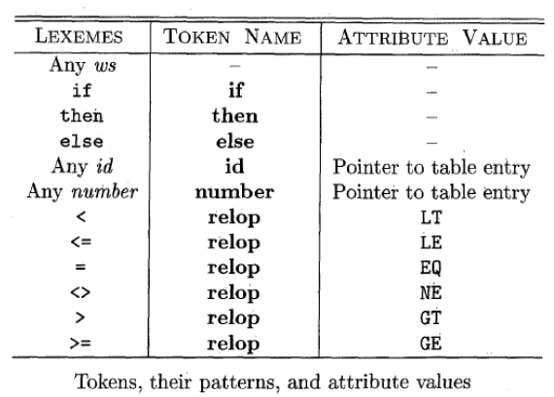
Overall
Note: Each token has a unique token identifier to define category of lexemes

Slide 18
Constructing Transition Diagrams for Tokens
Transition Diagrams (TD) are used to represent the tokens
As characters are read, the relevant TDs are used to attempt to match lexeme to a pattern
Each TD has:
  States : Represented by Circles
  Actions : Represented by Arrows between states
  Start State : Beginning of a pattern (Arrowhead)
  Final State(s) : End of pattern (Concentric Circles)
Each TD is Deterministic (assume) - No need to choose between 2 different actions !

Slide 19
Example TDs
> = :
start
>
=
RTN(GE)
0
6
7
other
*
RTN(GT)
8
We’ve accepted “>” and have read one extra char that must be unread.

Slide 20
Example : All RELOPs
start
<
=
0
1
2
return(relop, LE)
>
3
return(relop, NE)
other
*
=
4
return(relop, LT)
5
return(relop, EQ)
>
=
6
7
return(relop, GE)
other
*
8
return(relop, GT)

Slide 21
Example TDs : id and delim
id :
letter or digit
start
letter
other
*
9
10
11
return( get_token(), install_id())
Either returns ptr or “0” if reserved
delim :
delim
start
delim
other
*
28
29
30
Question: Why are there no TDs for then, else, if ?

Slide 22
What Else Does Lexical Analyzer Do?
All Keywords / Reserved words are matched as ids !!
So recognizing keywords and identifiers presents a problem.
There are two ways that we can handle reserved words that look like identifiers.

Slide 23
What Else Does Lexical Analyzer Do?
First Approach (Preferred):
Install the reserved words in the symbol table initially.
After the match, the symbol table or a special keyword table is consulted.
Keyword table contains string versions of all keywords and associated token values
if
15
then
16
begin
17
...
...
When a match is found, the token is returned, along with its symbolic value, i.e., “then”, 16
If a match is not found, then it is assumed that an id has been discovered

Slide 24
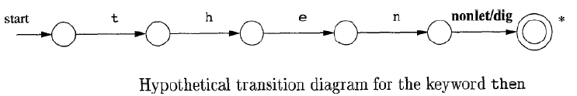
What Else Does Lexical Analyzer Do?
Second Approach :
Create separate transition diagrams for each keyword.

Slide 25
Example TDs : Unsigned Number
digit → 0 | 1 | 2 | … | 9
digits → digit digit*
optional_fraction → . digits | ∈
optional_exponent → ( E ( + | -| ∈) digits) | ∈
num → digits optional_fraction optional_exponent
1240, 39.45, 6.33E15, or 1.578E-41
Shorthand
digit → 0 | 1 | 2 | … | 9
digits → digit⁺
optional_fraction → (. digits ) ?
optional_exponent → ( E ( + | -) ? digits) ?
num → digits optional_fraction optional_exponent

Slide 26
Example TDs : Unsigned #s
digit
digit
digit
start
digit
.
digit
E
+ | -
digit
other
*
12
13
14
15
16
17
18
19
E
digit
digit
digit
start
digit
*
.
digit
other
*
20
21
22
23
24
return(num, install_num())
digit
start
digit
other
*
25
26
27
Questions: Is ordering important for unsigned #s ?

Slide 27
Implementing Transition Diagrams
A sequence of transition diagrams can be converted into a program to look for the tokens specified by the grammar
Each state gets a segment of code
FUNCTIONS USED
  nextchar(),
  retract(),
  install_num(),
  install_id(),
  gettoken(),
  isdigit(),
  isletter(),
  recover()

Slide 28
Implementing Transition Diagrams
int state = 0, start = 0
lexeme_beginning = forward;
token nexttoken()
{ while(1) {
switch (state) {
case 0: c = nextchar();
/* c is lookahead character */
if (c== blank || c==tab || c== newline) {
state = 0;
lexeme_beginning++;
/* advance
beginning of lexeme */
}
else if (c == ‘<‘) state = 1;
else if (c == ‘=‘) state = 5;
else if (c == ‘>’) state = 6;
else state = fail();
break;
… /* cases 1-8 here */
repeat
until
a “return”
occurs
start
0
<
1
=
2
>
3
other
=
4
*
5
>
6
=
7
other
*
8

Slide 29
Implementing Transition Diagrams, II
digit
*
digit
other
25
26
27
advances
forward
.............
case 25; c = nextchar();
if (isdigit(c)) state = 26;
else state = fail();
break;
case 26; c = nextchar();
if (isdigit(c)) state = 26;
else state = 27;
break;
case 27; retract(1); lexical_value = install_num();
return ( NUM );
.............
Case numbers correspond to transition diagram states !
looks at the region
lexeme_beginning ... forward
retracts
forward

Slide 30
Implementing Transition Diagrams, III
.............
case 9: c = nextchar();
if (isletter(c)) state = 10;
else state = fail();
break;
case 10; c = nextchar();
if (isletter(c)) state = 10;
else if (isdigit(c)) state = 10;
else state = 11;
break;
case 11; retract(1); lexical_value = install_id();
return ( gettoken(lexical_value) );
.............
letter or digit
*
letter
other
reads token
name from ST
9
10
11

Slide 31
When Failures Occur:
int fail()
{
forward = lexeme beginning;
switch (start) {
case 0: start = 9; break;
case 9: start = 12; break;
case 12: start = 20; break;
case 20: start = 25; break;
case 25: recover(); break;
default: /* lex error */
}
return start;
}
Switch to
next transition
diagram

Slide 32
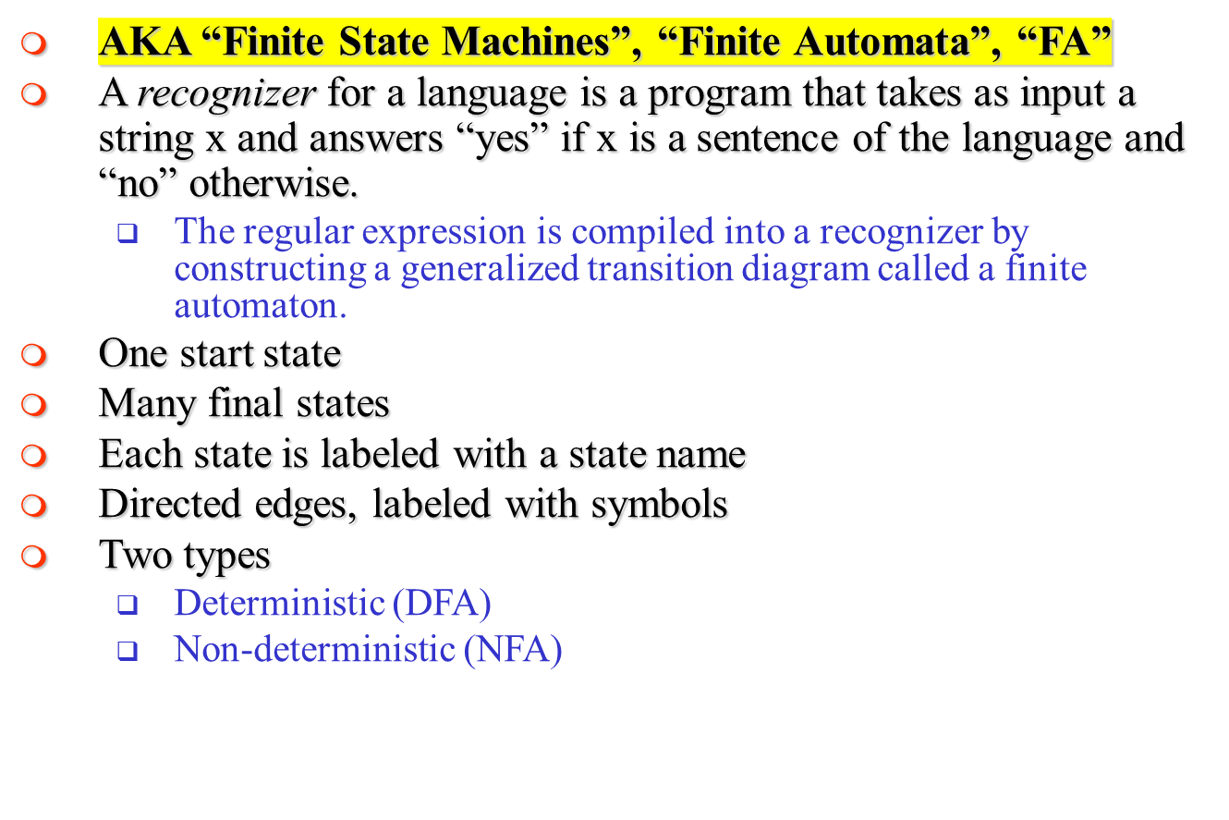
Finite State Automata (FSAs)

Slide 33
Simulation of a Finite Automata (FA)
s ← s₀
c ← nextchar;
while c ≠ eof do
s ← move(s,c);
c ← nextchar;
end;
if s is in F then return “yes”
else return “no”
DFA
simulation
S ← ∈-closure({s₀})
c ← nextchar;
while c ≠ eof do
S ← ∈-closure(move(S,c));
c ← nextchar;
end;
if S∩F≠∅ then return “yes”
else return “no”
NFA
simulation

Slide 34
Nondeterministic Finite Automata
A nondeterministic finite automaton (NFA) is mathematical model that consists of
A set of states S
A set of input symbols S
A transition function that maps state/symbol pairs to
a set of states
A special state s₀ called the start state
A set of states F (subset of S) of final states
INPUT: string
OUTPUT: yes or no

Slide 35
Example – NFA : (a|b)*abb
S = { 0, 1, 2, 3 }
s₀ = 0
F = { 3 }
Σ = { a, b }
a
start
0
a
1
b
2
b
3
b
i n p u t
∈ (null) moves possible
a
b
state
0
{ 0, 1 }
{ 0 }
i
∈
j
1
--
{ 2 }
Switch state but do not use any input symbol
2
--
{ 3 }
Transition Table

Slide 36

a
start
0
a
1
b
2
b
3
b
Given an input string, we trace moves
If no more input & in final state, ACCEPT
EXAMPLE: Input: ababb
-OR-
move(0, a) = 0
move(0, b) = 0
move(0, a) = 1
move(1, b) = 2
move(2, b) = 3
ACCEPT !
move(0, a) = 1
move(1, b) = 2
move(2, a) = ? (undefined)
REJECT !

Slide 37

We can handle undefined transitions by defining one more state, a “death” state, and transitioning all previously undefined transition to this death state.
a
start
0
a
1
b
2
b
3
b
a
a
a, b
4
Σ

Slide 38
Other Concepts
Not all paths may result in acceptance.
a
start
0
a
1
b
2
b
3
b
aabb is accepted along path : 0 → 0 → 1 → 2 → 3
BUT… it is not accepted along the valid path:
0 → 0 → 0 → 0 → 0

Slide 39
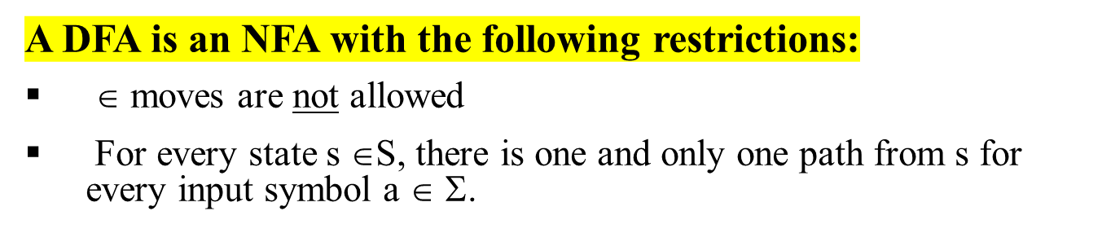
Deterministic Finite Automata
Since transition tables don’t have any alternative options, DFAs are easily simulated via an algorithm.
s ← s₀
c ← nextchar;
while c ≠ eof do
s ← move(s,c);
c ← nextchar;
end;
if s is in F then return “yes”
else return “no”

Slide 40
Example – DFA : (a|b)*abb
b
a
start
0
a
1
b
2
b
3
a
b
a
DFA
Recall the original NFA:
a
start
0
a
1
b
2
b
3
b

Slide 41
Relation between RE, NFA and DFA
There is an algorithm for converting any RE into an NFA.
There is an algorithm for converting any NFA to a DFA.
There is an algorithm for converting any DFA to a RE.
These facts tell us that REs, NFAs and DFAs have equivalent expressive power.
All three describe the class of regular languages.

Slide 42
NFA vs DFA
An NFA may be simulated by algorithm, when NFA is constructed from the R.E
Algorithm run time is proportional to |N| * |x| where |N| is the number of states and |x| is the length of input
Alternatively, we can construct DFA from NFA and uses it to recognize input
The space requirement of a DFA can be large. The RE (a+b)*a(a+b)(a+b)….(a+b) [n-1 (a+b) at the end] has no DFA with less than 2^{n} states. Fortunately, such RE in practice does not occur often
space required
time to simulate
NFA
O(|r|)
O(|r|*|x|)
DFA
O(2^{|r|})
O(|x|)
where |r| is the length of the regular expression.

Slide 43
Lexical Analyzer
Designing Lexical Analyzer Generator
  Reg. Expr. → NFA construction
  NFA → DFA conversion
  DFA simulation for lexical analyzer
  Each pattern recognizes lexemes. Longest prefix of input is matched. In case of tie the first pattern listed is chosed
  Each pattern described by regular expression
∈
(a | b)*abb
∈
(abc)*ab
∈
etc.
Recognizer!

Slide 44
Lex Specification → Lexical Analyzer
Let P₁, P₂, … , P_{n} be Lex patterns
  (regular expressions for valid tokens in prog. lang.)
Construct N(P₁), N(P₂), … N(P_{n})
Note: accepting state of N(P_{i}) will be marked by P_{i}
Construct NFA:
N(P₁)
Lex applies conversion algorithm to construct DFA that is equivalent!
∈
∈
N(P₂)
∈
N(P_{n})

Slide 45
Pictorially
Lex Specification
Lex Compiler
Transition Table
(a) Lex Compiler
lexeme
input buffer
FA
Simulator
Transition Table
(b) Schematic lexical analyzer

Slide 46
Converting Regular Expressions to NFAs
How do we define an NFA that accepts a regular expression?
It is very simple. Remember that a regular expression is
formed by the use of alternation, concatenation, and repetition.
Thus all we need to do is to know how to build the NFA
for a single symbol, and how to compose NFAs.

Slide 47
Converting Regular Expressions to NFAs
Thompson’s Construction
Empty string ε is a regular expression denoting { ε }
a is a regular expression denoting {a} for any a in Σ
start
ε
i
f
start
a
i
f

Slide 48
Converting Regular Expressions to NFAs
Composing NFAs with Alternation and Concatenation
If P and Q are regular expressions with NFAs N_{p}, N_{q}:
  P | Q (union)
  PQ (concatenation)
ε
N_{p}
ε
start
i
f
ε
N_{q}
ε
start
N_{p}
N_{q}
i
f

Slide 49
Converting Regular Expressions to NFAs
Composing NFAs with Repeation
If Q is a regular expression with NFA N_{q}:
  Q* (closure)
ε
start
ε
N_{q}
ε
i
f
ε

Slide 50
Example (ab* | a*b)*
Starting with:
ab*
start
a
a*b
start
b
1
2
3
4
b
a
ab* | a*b
a
ε
1
2
ε
start
5
b
6
ε
ε
3
b
4
a

Slide 51
Example (ab* | a*b)*
ab* | a*b
a
ε
1
2
ε
start
5
b
6
ε
ε
3
b
4
a
(ab* | a*b)*
a
ε
1
2
ε
start
ε
ε
7
5
b
6
8
ε
ε
ε
b
ε
3
4
a

Slide 52
Properties of Construction
Let r be a regular expression, with NFA N(r), then
N(r) has #of states ≤ 2*(#symbols + #operators) of r
N(r) has exactly one start and one accepting state
Each state of N(r) has at most one outgoing edge a∈Σ or at most two outgoing ∈-transition

Slide 53
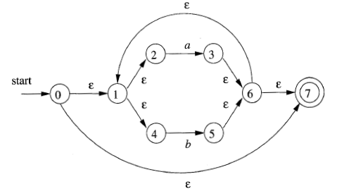
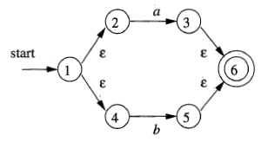
Detailed Example – NFA Construction(1)
(a|b)*abb
r₄:(r3)*
r₁:
a
r₂:
b
r₃:r1|r2

Slide 54

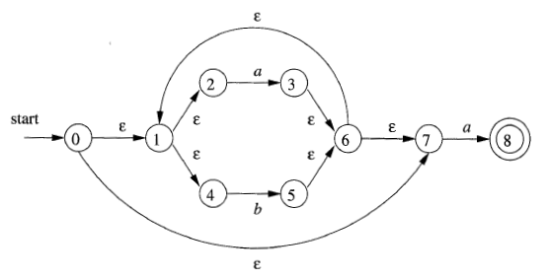
Detailed Example – NFA Construction(2)
(a|b)*abb
r₅
r₆: r4 r5

Slide 55
Detailed Example – Final Step
(a|b)*abb
r₁₀
b
b
8
9
10

Slide 56
Converting NFAs to DFAs
(subset construction)
Idea: Each state in the new DFA will correspond to some set of states from the NFA. The DFA will be in state {s₀,s₁,…} after input if the NFA could be in any of these states for the same input.
Input: NFA N with state set S_{N}, alphabet S, start state s_{N}, final states F_{N}, transition function T_{N}: S_{N} x {S U e} → S_{N}
Output: DFA D with state set S_{D}, alphabet S, start state
s_{D} = e-closure(s_{N}), final states F_{D}, transition function
T_{D}: S_{D} x S → S_{D}

Slide 57
Terminology: ε-closure
ε-closure(T) = T + all NFA states reachable from any state in T using only ε transitions.
b
1
2
b
b
ε-closure({1,2,5}) = {1,2,5}
ε-closure({4}) = {1,4}
ε-closure({3}) = {1,3,4}
ε-closure({3,5}) = {1,3,4,5}
a
ε
5
a
3
ε
4

Slide 58
Illustrating Conversion – An Example
Start with NFA: (a | b)*abb
∈
a
2
3
∈
∈
start
∈
∈
a
b
0
1
6
7
8
9
∈
∈
b
b
4
5
10
∈
First we calculate: ∈-closure(0) (i.e., state 0)
∈-closure(0) = {0, 1, 2, 4, 7} (all states reachable from 0
on ∈-moves)
Let A={0, 1, 2, 4, 7} be a state of new DFA, D.

Slide 59
Conversion Example – continued (1)
2nd , we calculate : a : ∈-closure(move(A,a)) and
b : ∈-closure(move(A,b))
a : ∈-closure(move(A,a)) = ∈-closure(move({0,1,2,4,7},a))}
adds {3,8} ( since move(2,a)=3 and move(7,a)=8)
From this we have : ∈-closure({3,8}) = {1,2,3,4,6,7,8}
(since 3→6 →1 →4, 6 →7, and 1 →2 all by ∈-moves)
Let B={1,2,3,4,6,7,8} be a new state. Define Dtran[A,a] = B.
b : ∈-closure(move(A,b)) = ∈-closure(move({0,1,2,4,7},b))
adds {5} ( since move(4,b)=5)
From this we have : ∈-closure({5}) = {1,2,4,5,6,7}
(since 5→6 →1 →4, 6 →7, and 1 →2 all by ∈-moves)
Let C={1,2,4,5,6,7} be a new state. Define Dtran[A,b] = C.

Slide 60
Conversion Example – continued (2)
3rd , we calculate for state B on {a,b}
a : ∈-closure(move(B,a)) = ∈-closure(move({1,2,3,4,6,7,8},a))}
= {1,2,3,4,6,7,8} = B
Define Dtran[B,a] = B.
b : ∈-closure(move(B,b)) = ∈-closure(move({1,2,3,4,6,7,8},b))}
= {1,2,4,5,6,7,9} = D
Define Dtran[B,b] = D.
4th , we calculate for state C on {a,b}
a : ∈-closure(move(C,a)) = ∈-closure(move({1,2,4,5,6,7},a))}
= {1,2,3,4,6,7,8} = B
Define Dtran[C,a] = B.
b : ∈-closure(move(C,b)) = ∈-closure(move({1,2,4,5,6,7},b))}
= {1,2,4,5,6,7} = C
Define Dtran[C,b] = C.

Slide 61
Conversion Example – continued (3)
5th , we calculate for state D on {a,b}
a : ∈-closure(move(D,a)) = ∈-closure(move({1,2,4,5,6,7,9},a))}
= {1,2,3,4,6,7,8} = B
Define Dtran[D,a] = B.
b : ∈-closure(move(D,b)) = ∈-closure(move({1,2,4,5,6,7,9},b))}
= {1,2,4,5,6,7,10} = E
Define Dtran[D,b] = E.
Finally, we calculate for state E on {a,b}
a : ∈-closure(move(E,a)) = ∈-closure(move({1,2,4,5,6,7,10},a))}
= {1,2,3,4,6,7,8} = B
Define Dtran[E,a] = B.
b : ∈-closure(move(E,b)) = ∈-closure(move({1,2,4,5,6,7,10},b))}
= {1,2,4,5,6,7} = C
Define Dtran[E,b] = C.

Slide 62
Conversion Example – continued (4)
This gives the transition table Dtran for the DFA of:
Input Symbol
Dstates
a
b
A B C
B B D
C B C
D B E
E B C
b
b
C
b
start
A
a
B
b
D
b
E
a
a
a

Slide 63
Algorithm For Subset Construction
computing the
∈-closure
push all states in T onto stack;
initialize ∈-closure(T) to T;
while stack is not empty do begin
pop t, the top element, off the stack;
for each state u with edge from t to u labeled ∈ do
if u is not in ∈-closure(T) do begin
add u to ∈-closure(T) ;
push u onto stack
end
end

Slide 64
Algorithm For Subset Construction – (2)
initially, ∈-closure(s₀) is only (unmarked) state in Dstates;
while there is unmarked state T in Dstates do begin
mark T;
for each input symbol a do begin
U := ∈-closure(move(T,a));
if U is not in Dstates then
add U as an unmarked state to Dstates;
Dtran[T,a] := U
end
end

Slide 65
Example 2: Subset Construction
NFA N with
  State set S_{N} = {1,2,3,4,5},
  Alphabet Σ = {a,b}
  Start state s_{N}=1,
  Final states F_{N}={5},
  Transition function T_{N}: S_{N} x {Σ ∪ ε} → S_{N}
NFA
start
ε
1
2
a,b
a
b
5
a,b
3
4
 | a | b | ε
1 | 3 | - | 2
2 | 5 | 5, 4 | -
3 | - | 4 | -
4 | 5 | 5 | -
5 | - | - | -
b

Slide 66
Example 2: Subset Construction
NFA
start
1,2
start
ε
1
2
a,b
a
b
5
a,b
3
4
T | ∈-closure(move(T, a)) | ∈-closure(move(T, b))
{1,2}
b

Slide 67
Example 2: Subset Construction
NFA
start
b
1,2
4,5
start
ε
a
1
2
a,b
a
b
5
3,5
a,b
T | ∈-closure(move(T, a)) | ∈-closure(move(T, b))
{1,2} | {3,5} | {4,5}
{3,5}
{4,5}
3
4
b

Slide 68
Example 2: Subset Construction
NFA
start
b
1,2
4,5
start
ε
a
1
2
a,b
b
3,5
b
4
a
5
a,b
T | ∈-closure(move(T, a)) | ∈-closure(move(T, b))
{1,2} | {3,5} | {4,5}
{3,5} | - | {4}
{4,5}
{4}
3
4
b

Slide 69
Example 2: Subset Construction
NFA
start
b
a,b
1,2
4,5
5
start
ε
a
1
2
a,b
b
3,5
b
4
a
5
a,b
T | ∈-closure(move(T, a)) | ∈-closure(move(T, b))
{1,2} | {3,5} | {4,5}
{3,5} | - | {4}
{4,5} | {5} | {5}
{4}
{5}
3
4
b

Slide 70
Example 2: Subset Construction
NFA
start
b
a,b
1,2
4,5
5
start
ε
a
a,b
1
2
a,b
b
3,5
b
4
a
5
a,b
T | ∈-closure(move(T, a)) | ∈-closure(move(T, b))
{1,2} | {3,5} | {4,5}
{3,5} | - | {4}
{4,5} | {5} | {5}
{4} | {5} | {5}
{5} | - | -
3
4
b

Slide 71
Example 2: Subset Construction
start
b
1,2
4,5
a,b
5
NFA
a
a,b
start
ε
b
1
2
a,b
3,5
4
a
b
5
a,b
T | ∈-closure(move(T, a)) | ∈-closure(move(T, b))
{1,2} | {3,5} | {4,5}
{3,5} | - | {4}
{4,5} | {5} | {5}
{4} | {5} | {5}
{5} | - | -
3
4
b
All final states since the
NFA final state is included

Slide 72
Example 3: Subset Construction
NFA
start
b
1
2
b
a
ε
b
5
a
3
ε
4

Slide 73
Example 3: Subset Construction
NFA
DFA
start
b
start
a
1
2
b
1
1,3,4
ε
b
5
b
b
a
a
a
2
b
a
3
4
1,3,
4,5
ε
b
b
a
1,4,5

Slide 74
Example 4: Subset Construction
NFA
DFA
start
b
ε
b
start
1
2
a
3
5
1,2,4
ε
a
b
b
b
3,4
3,5
3
a
4
5
b
b
a
4
a

Slide 75
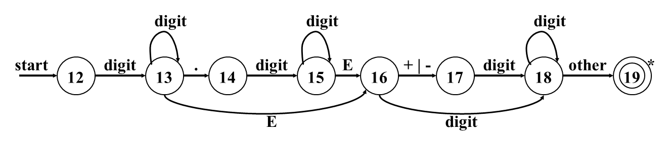
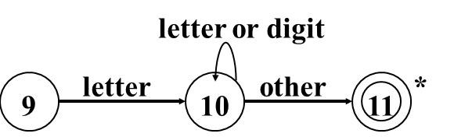

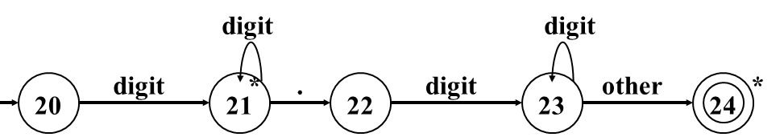
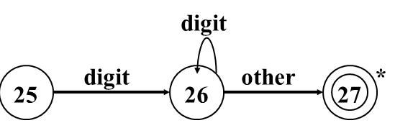

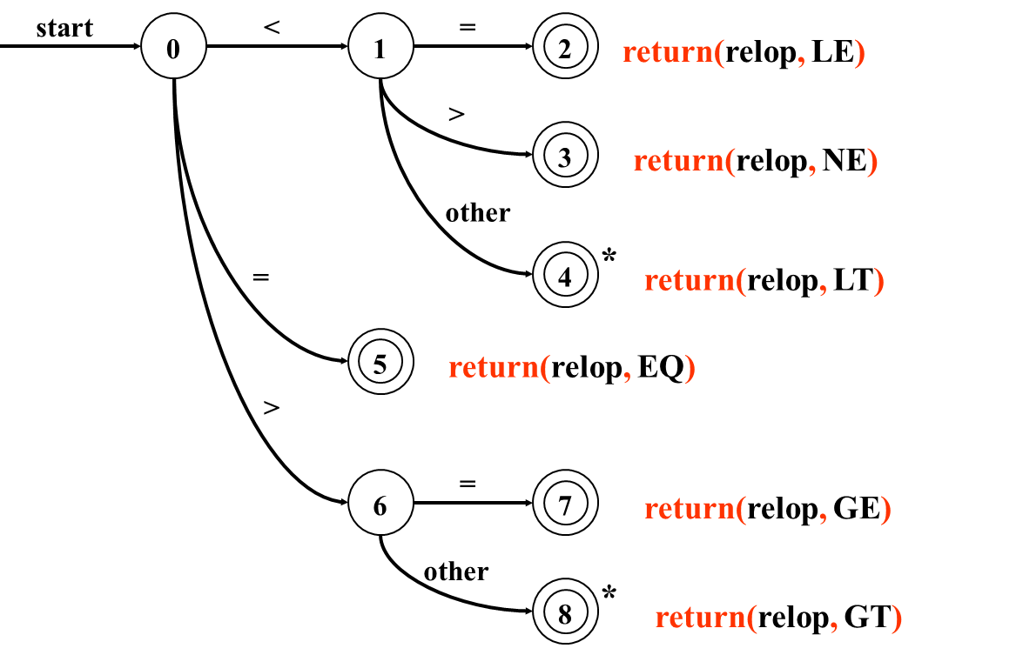
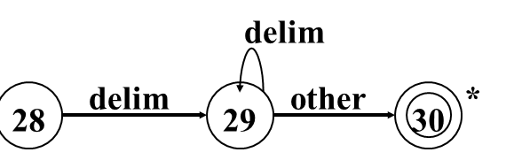
NFA: Transition Diagram capturing Multiple Tokens
Questions: Draw the transition diagram that will recognize id, keywords, number, whitespaces and relational operators?
ε
ε
ε
ε
ε

Slide 76
Corresponding DFA: Transition Diagram capturing Multiple Tokens
Questions: Draw the transition diagram that will recognize id, keywords, number, whitespaces and relational operators?

Slide 77
Converting DFAs to REs
Combine serial links by concatenation
Combine parallel links by alternation
Remove self-loops by Kleene closure
Select a node (other than initial or final) for removal. Replace it with a set of equivalent links whose path expressions correspond to the in and out links
Repeat steps 1-4 until the graph consists of a single link between the entry and exit nodes.

Slide 78
Example: DFAs to REs
a
a
start
d
b
d
a
b
d
0
1
2
3
4
5
c
c
d
b
b
6
c
7
parallel edges become alternation
start
d
a|b|c
d
a
d
0
1
2
3
4
5
d
b
b|c
6
7

Slide 79
Example: DFAs to REs
start
d
a|b|c
d
a
d
0
1
2
3
4
5
d
b
b|c
6
7
serial edges become concatenation
start
d (a|b|c) d
a
d
0
3
4
5
b (b|c) d

Slide 80
Example: DFAs to REs
start
d (a|b|c) d
a
d
0
3
4
5
b (b|c) d
Find paths that can be “shortened”
start
d (a|b|c) d
a
d
0
3
4
5
b(b|c)da

Slide 81
Example: DFAs to REs
start
d (a|b|c) d
a
d
0
3
4
5
b(b|c)da
eliminate self-loops
start
d (a|b|c) d
a
(b(b|c)da)*d
0
3
4
5
serial edges become concatenation
start
d (a|b|c) d
a
(b(b|c)da)*d
0
5

Slide 82
Exercises for Practice
Dragon Book (Chapter-3):
  3.3.5, 3.4.1, 3.4.2, 3.6.2, 3.6.3, 3.6.4, 3.6.5,
  3.7.1, 3.7.2, 3.7.3

